Slide 1
Song Recognizer

Slide 2
CONTEXT
Introduction.
Data Generation.
Transformation Of Data Set.
Extracting Important Features.
Prediction.

Slide 3
In this project, we have applied transfer learning techniques and build a deep learning model that can recognize the voice of an artist (also known as dynamic voice identifier) for a given song with minimal training data. To create such a system, naturally the tool of choice would be an image classifier.
We have first collected the songs and then by generating spectrogram of each song of various artists we create our dataset. We analyse data on various aspects like frequency, pitch, vibrations, wavelength etc.
Afterwards, we have selected the model VGG16 which is based upon transfer learning and best for image processing. VGG model using the pre-trained weights provided by the Oxford group and use it as a starting point in your own model, or use it as a model directly for classifying images.
INTRODUCTION

Slide 4
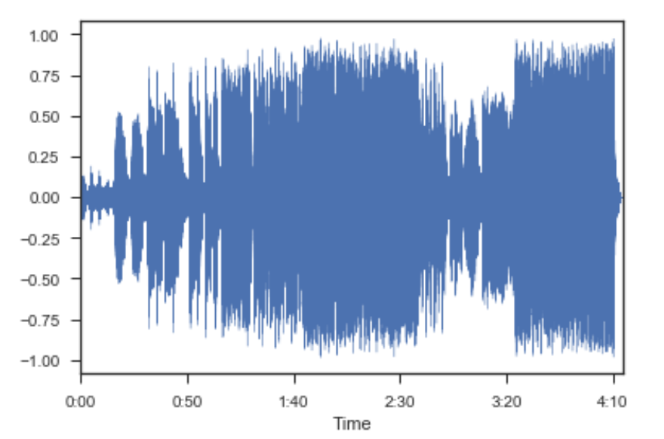
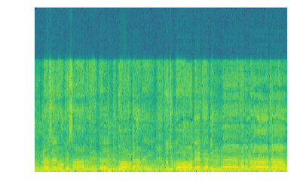
Spectrogram : WavePlot:

Slide 5
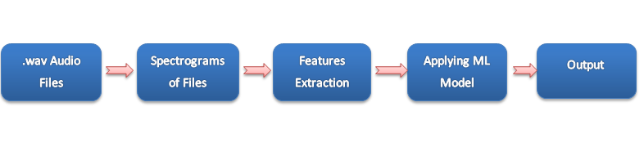
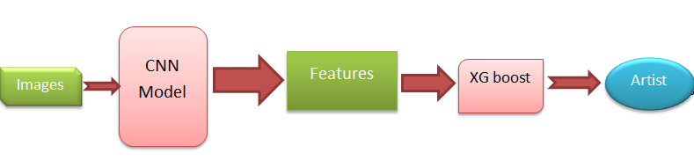
Methodology:

Slide 6
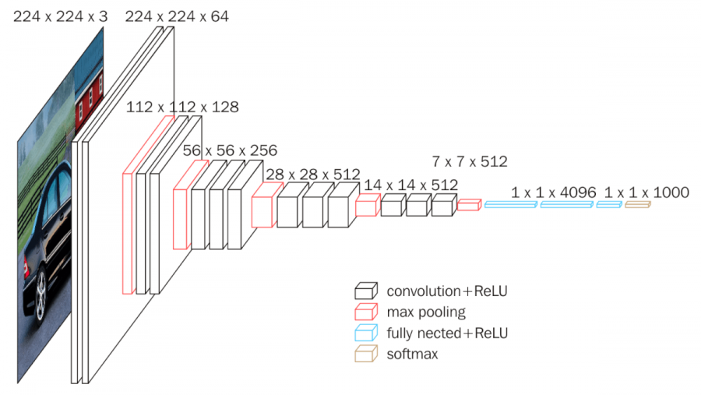
VGGNet consists of 16 convolutional layers and is very appealing because of its very uniform architecture

Slide 7
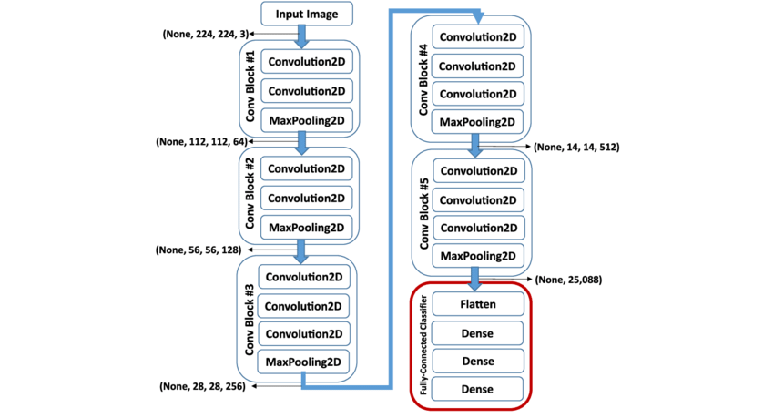
Functionality.

Slide 8
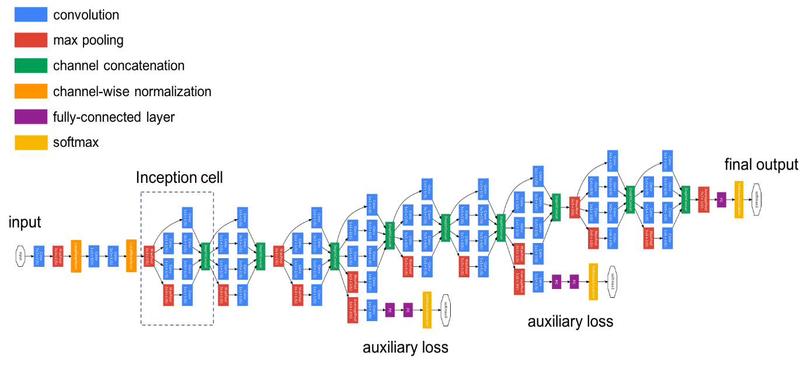
Functionality Contd….

Slide 9
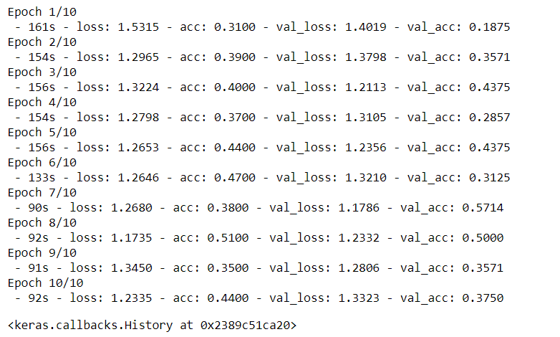
Predicting on the basis of previous trained data:
.

Slide 10
Scope for future development :
The project has a very vast scope in future. The project can be implemented on intranet in future. Project can be updated in near future as and when requirement for the same arises, as it is very flexible in terms of expansion. With the proposed software of database Space Manager ready and fully functional the client is now able to manage and hence run the entire work in a much better, accurate and error free manner.

Slide 11
References :
https://en.wikipedia.org/wiki/Support_vector_machine#Applications
http://scikit-learn.org/stable/modules/svm.html
Udacity lectures (Machine Learning Nano Degree)
http://scikit-learn.org/stable/modules/sgd.html
https://brilliant.org/wiki/k-nearest-neighbors/#pros-and-cons
http://scikit-learn.org/stable/tutorial/machine_learning_map/index.html

